Slide 1


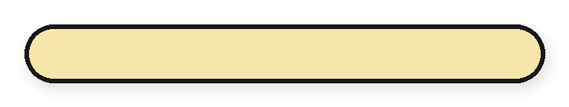
0%
Everything blue is a guide. Delete it before you download.
making one [smoothie]
start to
finish
Notes:
Slide 1. Hook. Swap in a photo of you making it. Edit [smoothie].

Slide 2
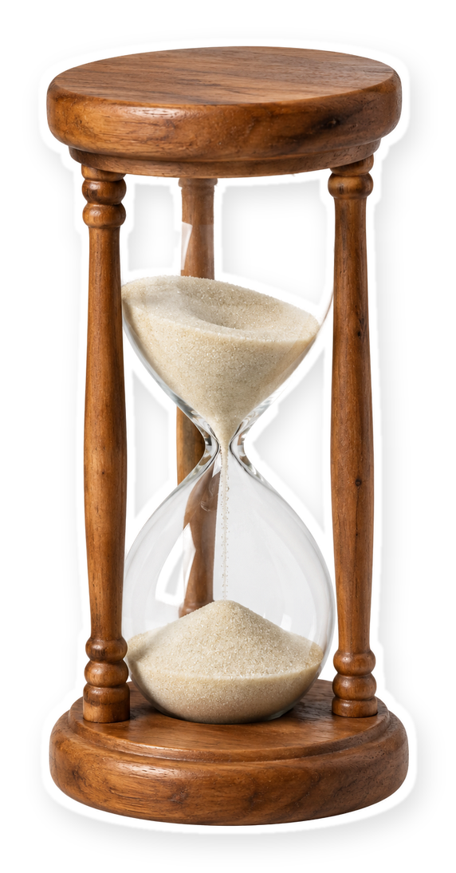
[how long does
one really take?]
[watch it get made]
Notes:
Slide 2. Second hook: Instagram often shows a carousel starting on slide 2, so this one works as a cover on its own. No photo needed. Edit both [bracket] lines.

Slide 3


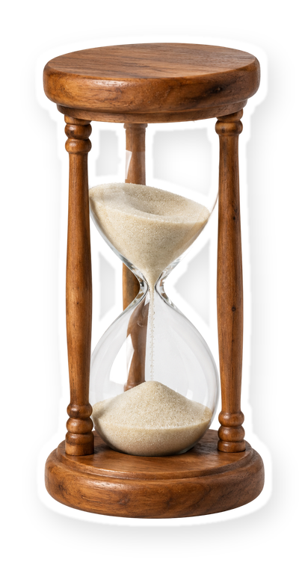
0%
it starts as
[a pile of fruit]
Notes:
Slide 3. Swap in a photo of your raw materials. Edit the line.

Slide 4
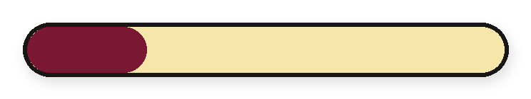
25%
[stage one: prep]
Notes:
Slide 4. Stage 1: swap in its photo and name it.

Slide 5
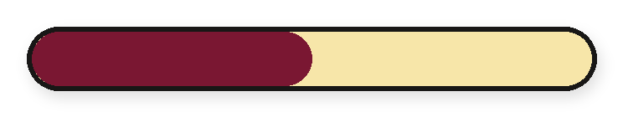




50%
[20 minutes
later]
[stage two: mix]
Notes:
Slide 5. Stage 2: swap in its photo. Edit the note and the stage name.

Slide 6
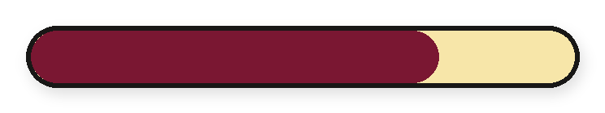


75%
almost...
[stage three: blend]
Notes:
Slide 6. Stage 3: swap in its photo (in the arch). Name it.

Slide 7
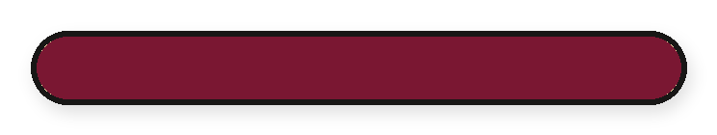
100%
finished.
Notes:
Slide 7. The finished one: swap in its photo.

Slide 8
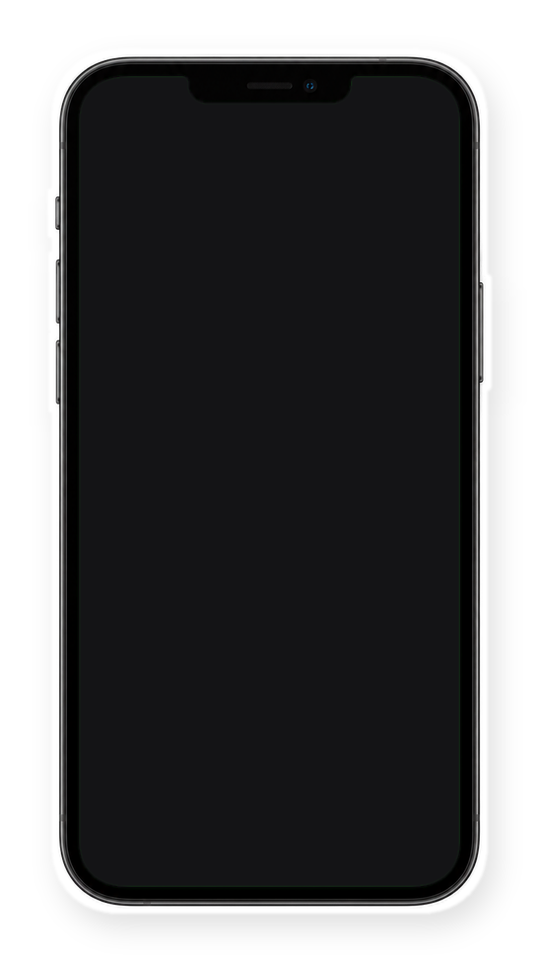

Comment
"[KEYWORD]"
[handmade in
Austin]
Notes:
Slide 8. Swap in a screenshot of your shop for the phone screen. Type your keyword. Caption to start from (CTA in the first two sentences, 3 hashtags): Comment [KEYWORD] and I will send you [the link]. [One line of real context: who it helps or how you use it.] #[tag] #[tag] #[tag]

